Slide 1
Semeion Digit Classification
05/03
Group 5: Gnanadeep Chinnabathini &
Yingjie Chen

Slide 2
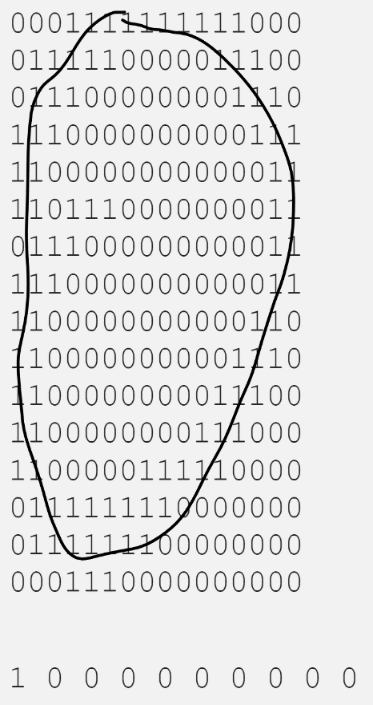
Understanding of the Semeion Dataset
Structure of the dataset:
1593 rows, 266 columns
Exploratory model building
Classification methods
(naïve bayes, kNN, SVM, Neural Networks)
Selecting test samples

Slide 3
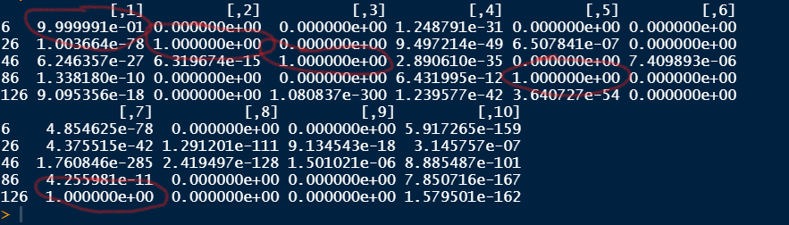
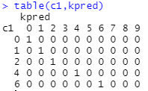
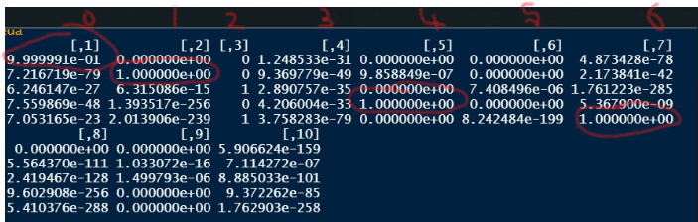
Results & Findings
All methods except naïve bayes gave an accuracy over 90%
 | probability
0 | 0.993876088
1 | 0.938311083
2 | 0.998307026
4 | 0.9843912
6 | 0.9752526
Two setups of neural networks, top: (16,8); bottom (64,32,16,8,1)
kNN (left) and SVM (right) results

Slide 4
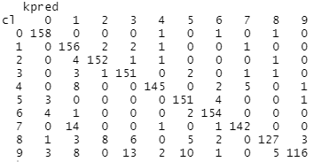
Difficulties & Further Improvement
Performing CV on SVM by training on probabilities
Tuning neural networks
tune.nnet(x, y = NULL, data = NULL, size = NULL, decay = NULL, trace = FALSE, tunecontrol = tune.control(nrepeat = 5), ...)
best.nnet(x, tunecontrol = tune.control(nrepeat = 5), ...)
Cross-Validation Results on kNN

